Slide 1
Group 1
Viviane Adohouannon
Kate Alexander
Juan Arangote
Dian Azbel
Vinayak Baburaj
Igor Baranov
Introduction

Slide 2
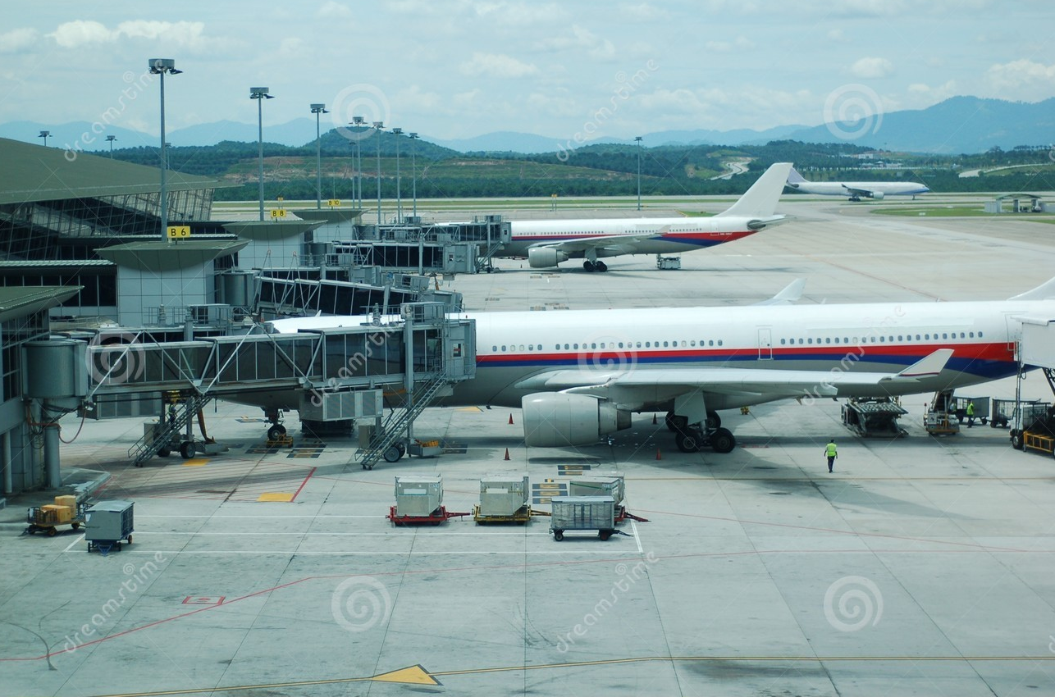
SFO Gates - Weekly Allocation – input 1
Our Research
Mundane part of modern life

Slide 3
SFO Gates - Weekly Allocation – input 1
Regulatory
Airport Operator
Airlines
Passengers / Guests
Environment
Baggage
Climate Control
Key Stakeholders
Check-in
Fire and Emergency
Airports are complex systems
Safety
Retail
Finance & Accounts
Treasury
Gates
Security
Land Use
Facilities
HR

Slide 4
SFO Gates - Weekly Allocation – input 1
Regulatory
Airport Operator
Airlines
Passengers / Guests
Environment
Baggage
Climate Control
Breakdown Impact
Check-in
Fire and Emergency
Experience
Costs
Brand / Goodwill
Safety
Retail
Finance & Accounts
Treasury
Gates
Security
Land Use
Facilities
HR

Slide 5
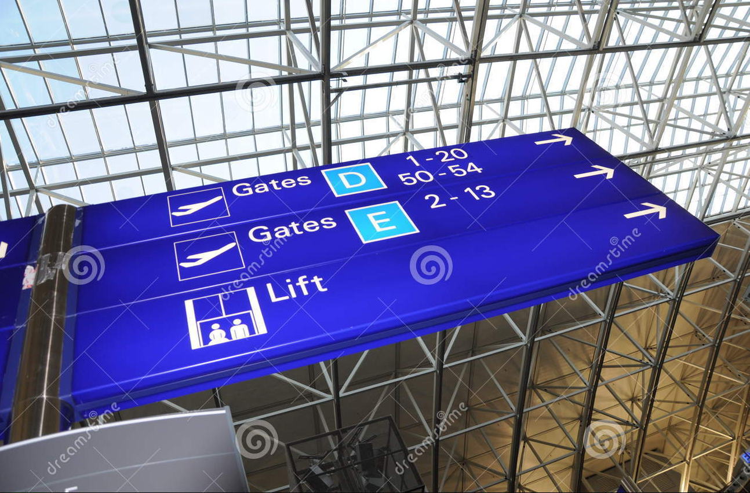
SFO Gates - Weekly Allocation – input 1
Gates Management
Hand Off Between Airline and Airport

Slide 6
SFO Gates - Weekly Allocation – input 1
Airline Performance
Delays
Cancellations
Gates Management
Hand Off Between Airline and Airport

Slide 7
SFO Gates - Weekly Allocation – input 1
Baseline
Paint the Future
Action Plan
Operational Performance
Sub-Optimal Cost
Forecast
Estimate Costs
Recommendation
Linear Programming
Business Goal
How does sub-optimal gate management affect stakeholders?

